Slide 1
Learning XOR
김문기, 노윤지

Slide 2
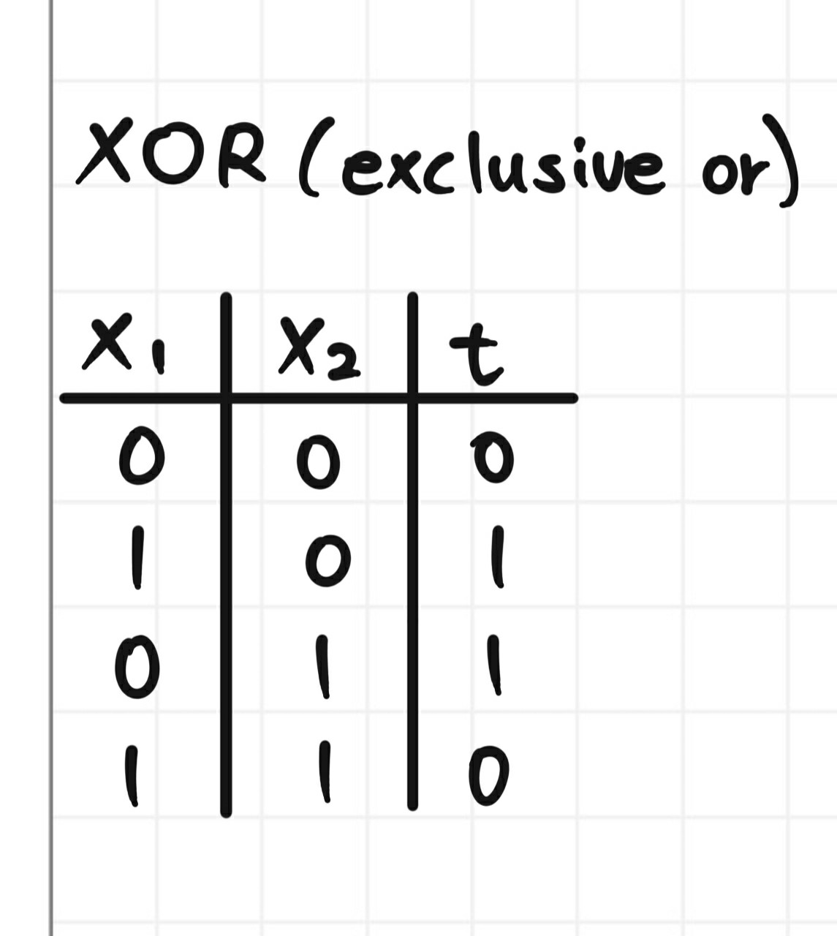
Learning XOR

Slide 3
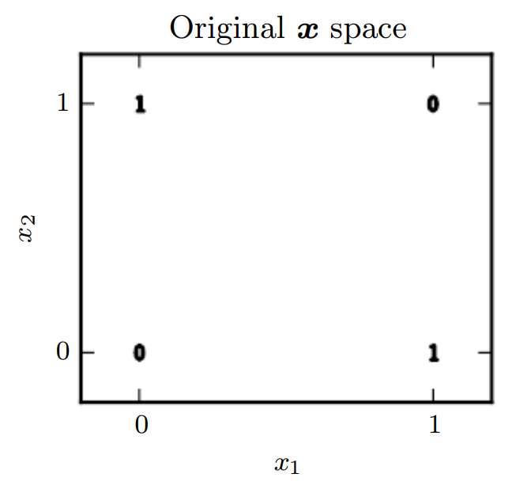
Learning XOR

Slide 4
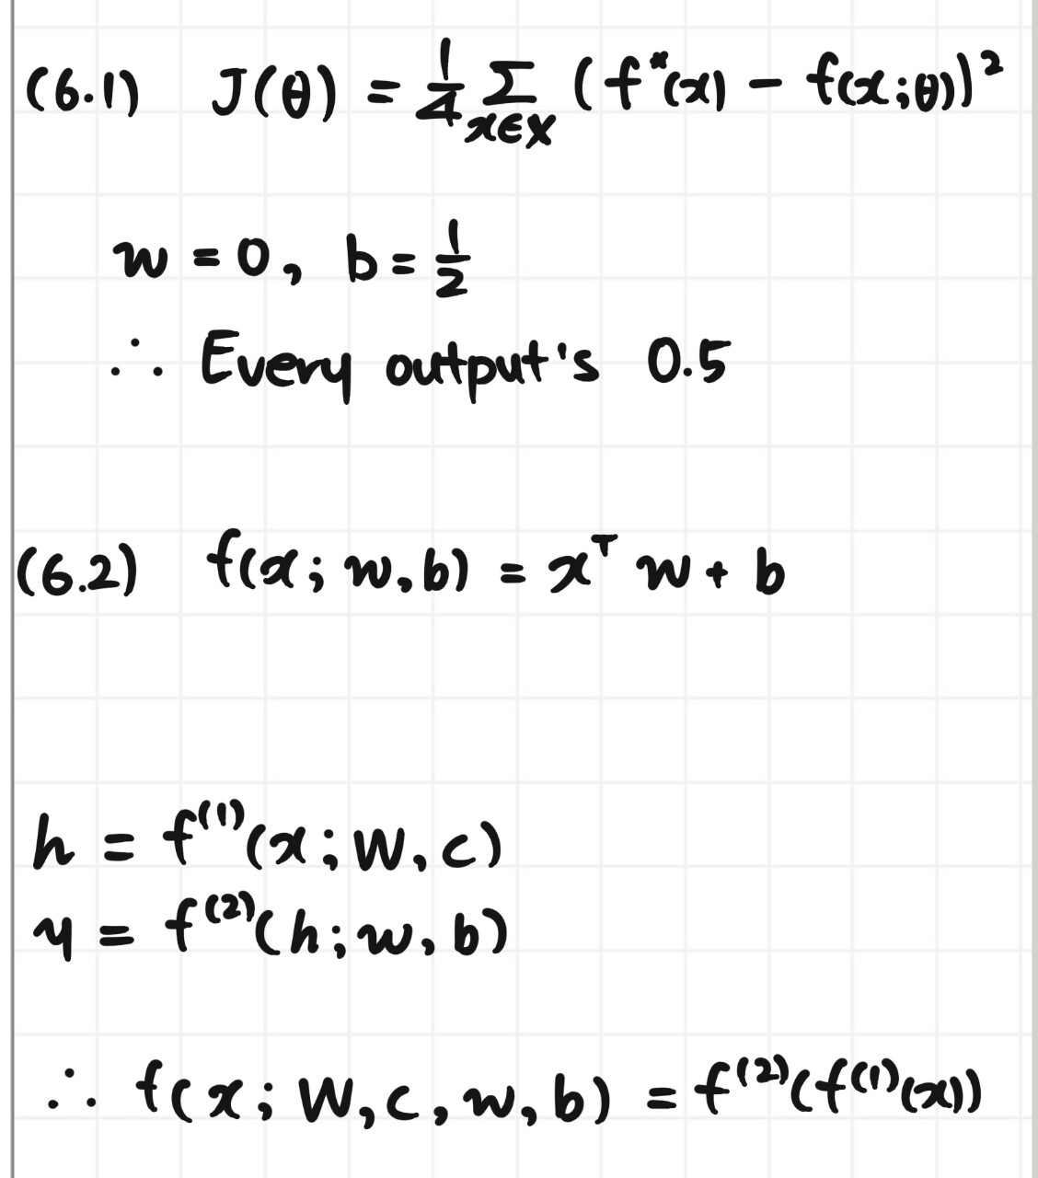
Learning XOR

Slide 5
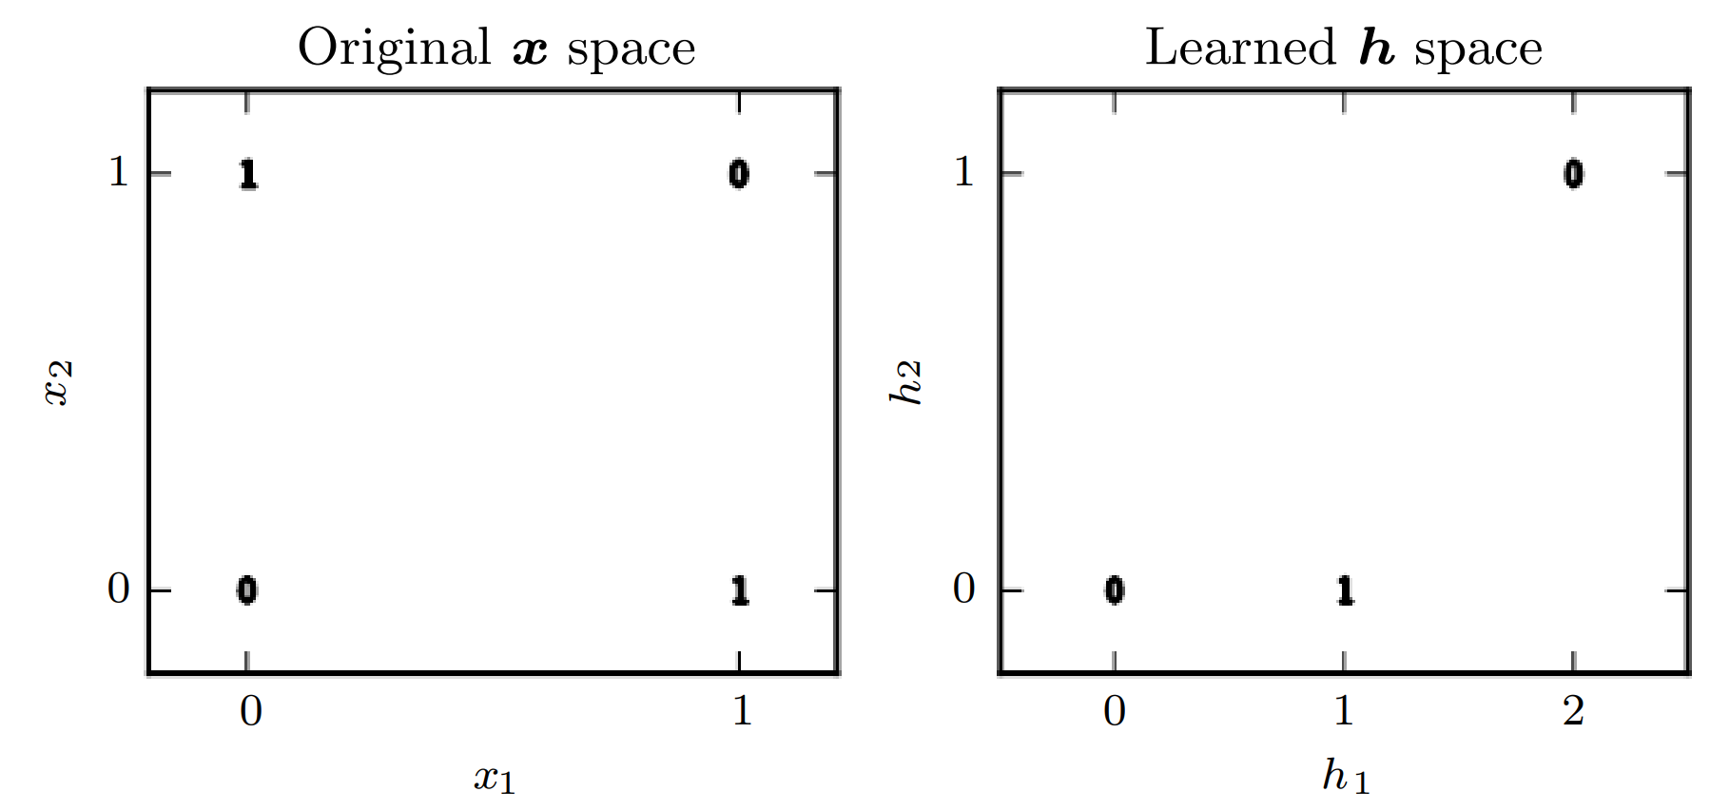
Learning XOR

Slide 6
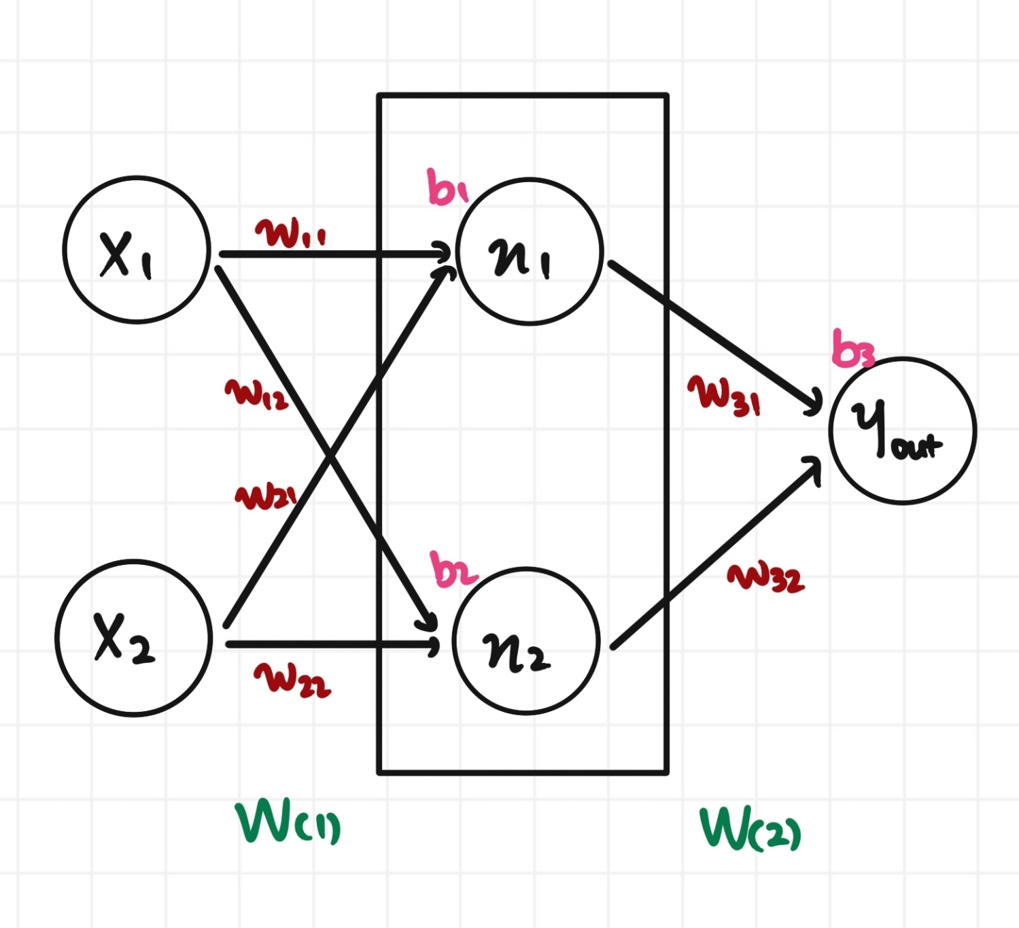
Learning XOR

Slide 7
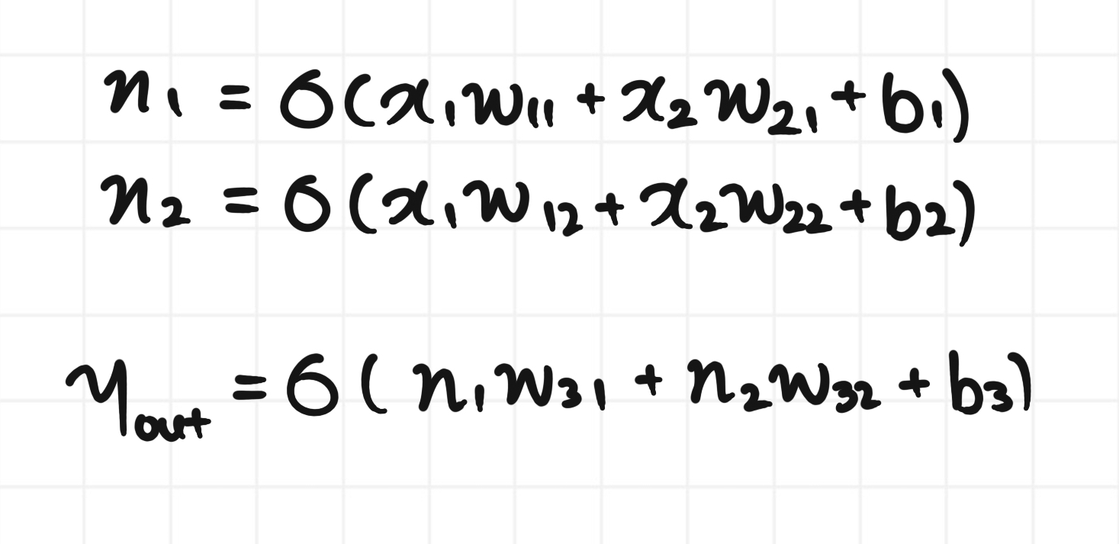
Learning XOR

Slide 8
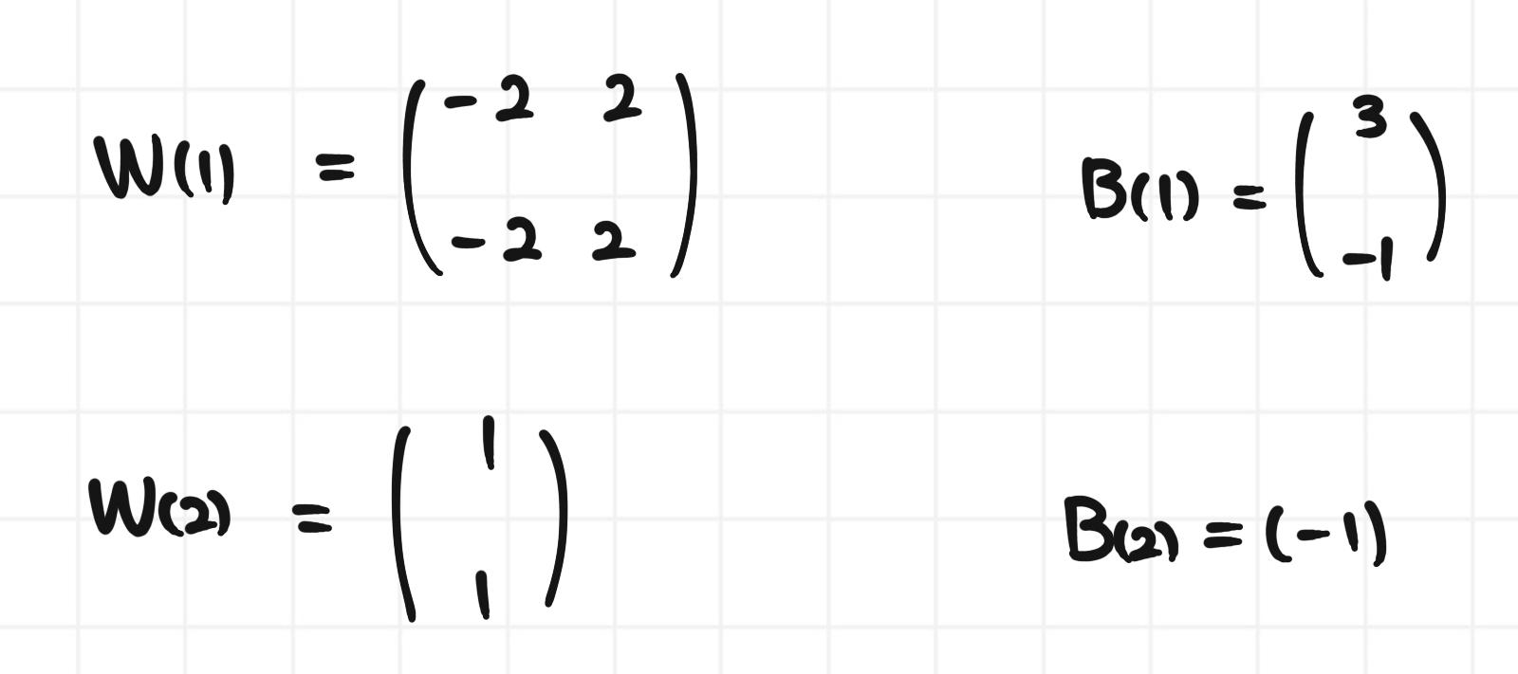
Learning XOR

Slide 9
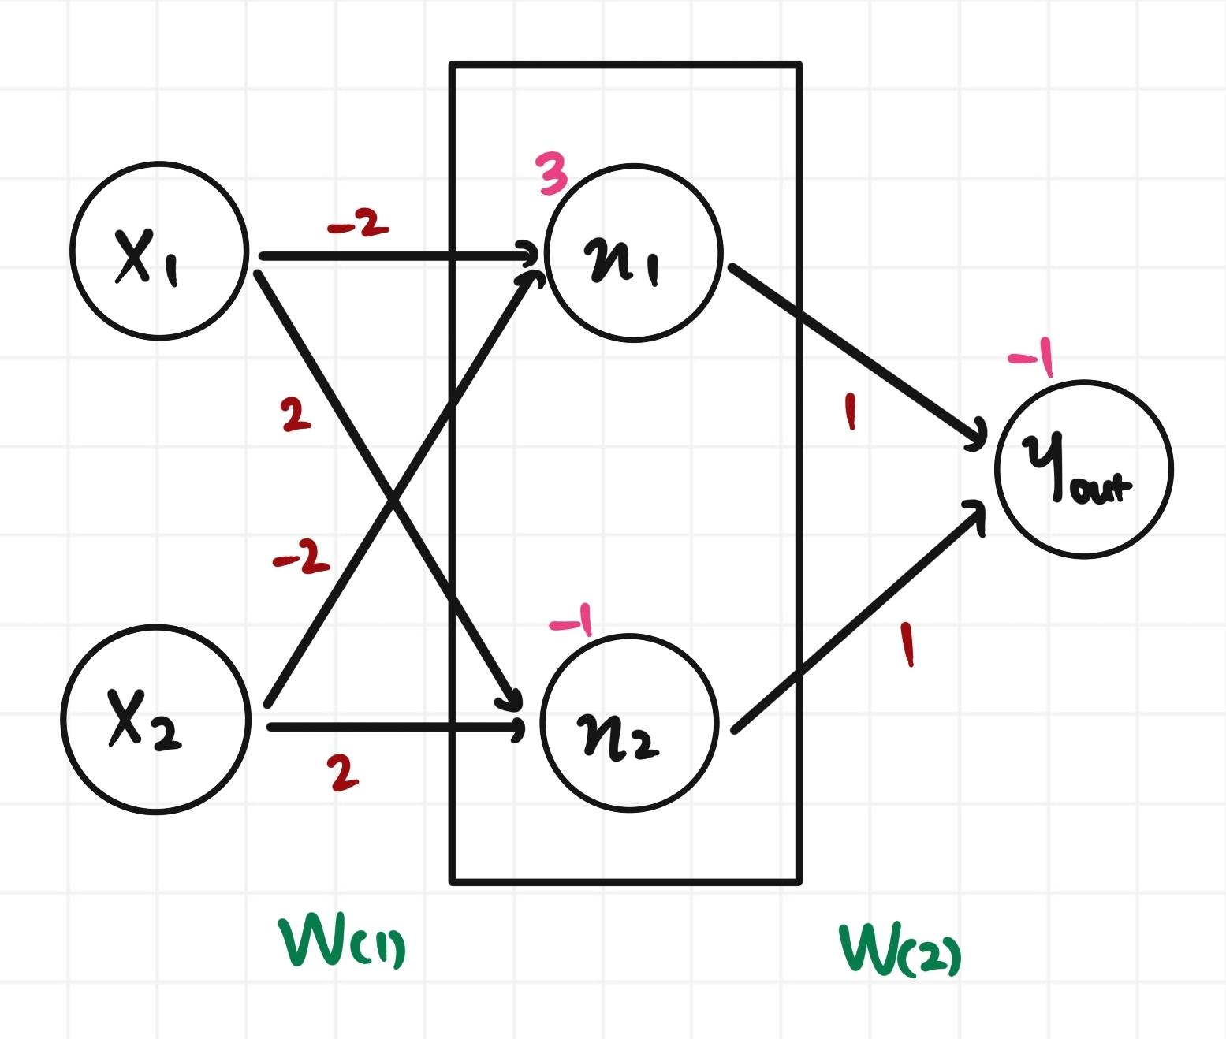
Learning XOR

Slide 10
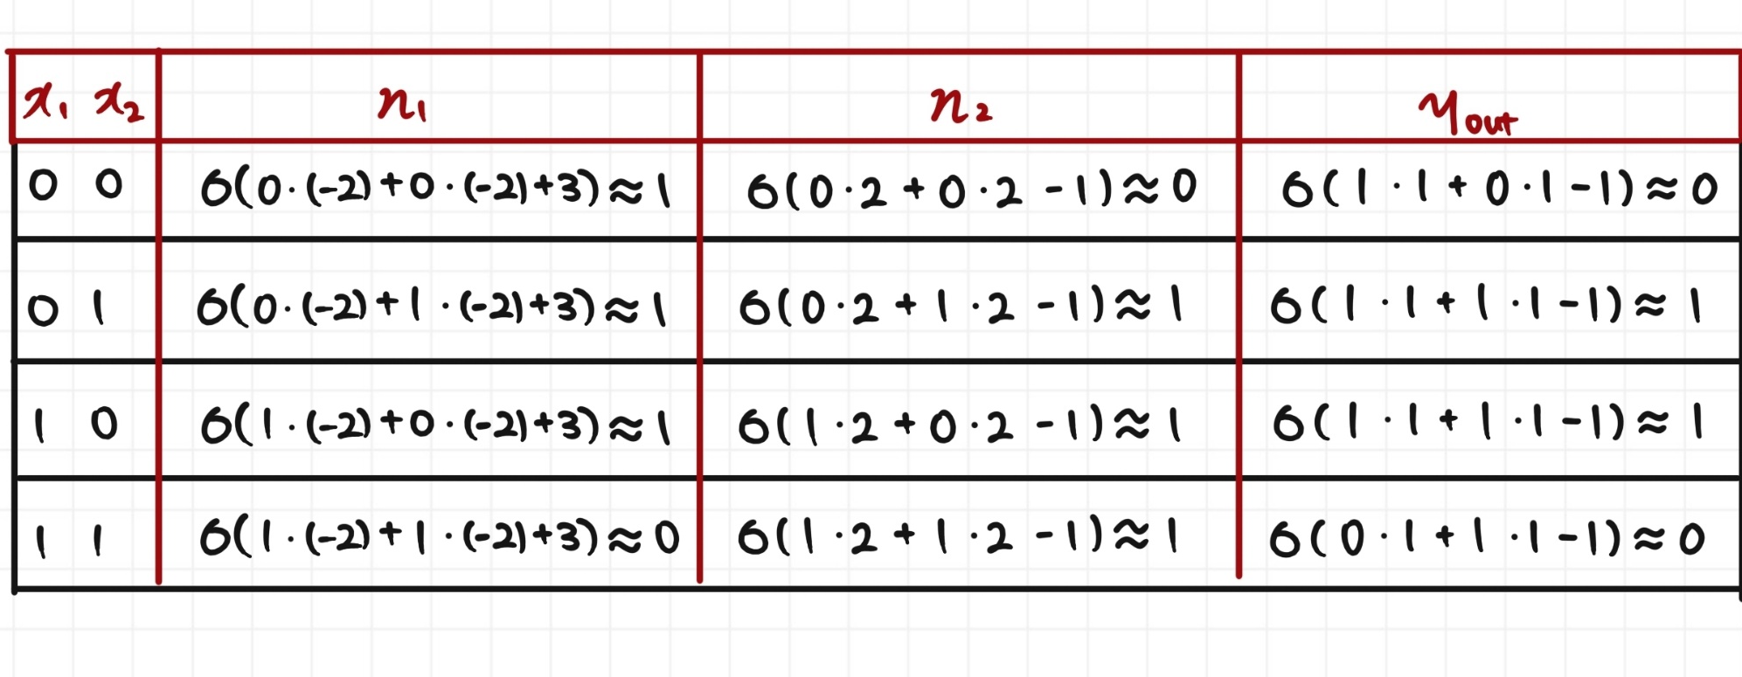
Learning XOR

